Slide 1
Chapter 6. Protozoa
6.1 Evolutionary status
6.2 Composition of a protozoan
6.3 Symbiotic lifestyle
6.4 Protozoan taxonomy (key)

Slide 2
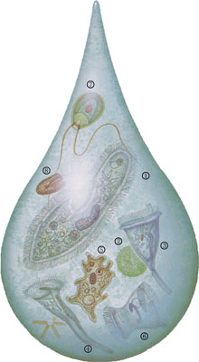
Protozoan animals found from
a drop of pond water
1.草履虫
2.团藻
3.钟形虫
4.喇叭虫
5.变形虫
6.毛口虫
7.单胞藻
8.唇滴虫

Slide 3
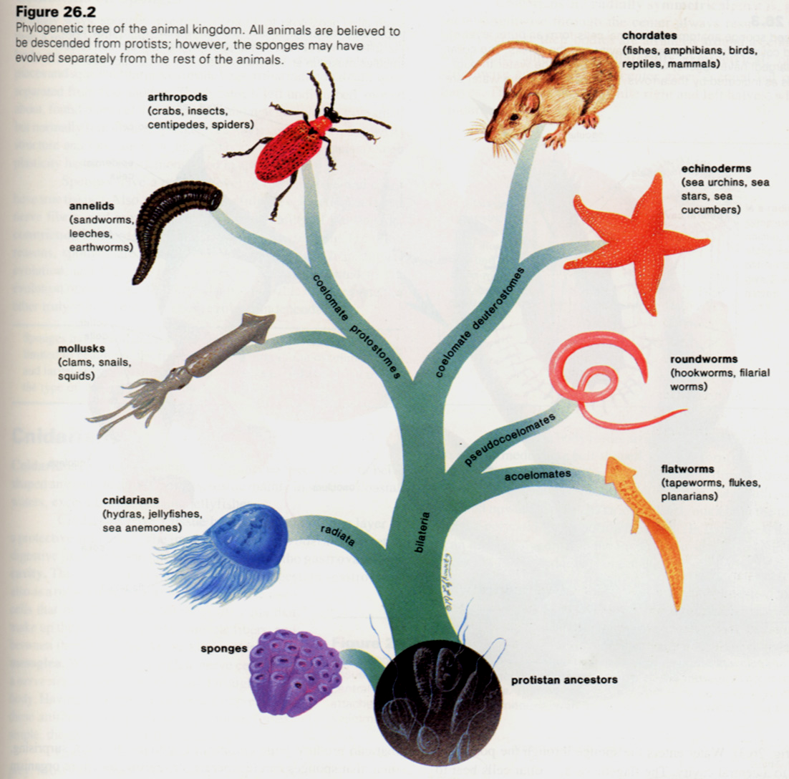
6.1 Evolutionary status
Protozoa 原生动物门
Spongia 海绵动物门
Coelenterata 腔肠动物门
Platyhelminthes 扁形动门
Pseudocoelomates假体腔动物
Annelida 环节动物门
Mol1usca 软体动物门
Arthropoda 节肢动物门
Echinodermata 棘皮动物门
Chordata 脊索动物门

Slide 4
Protozoans
The most ancient, primitive single-celled eukaryotes;
The whole body is a cell and the single cell is an independent, complete organism;
There are many kinds of organelles, and all life activities are carried out within a single plasma membrane;
It is more complex than any particular cell in higher organisms.

Slide 5
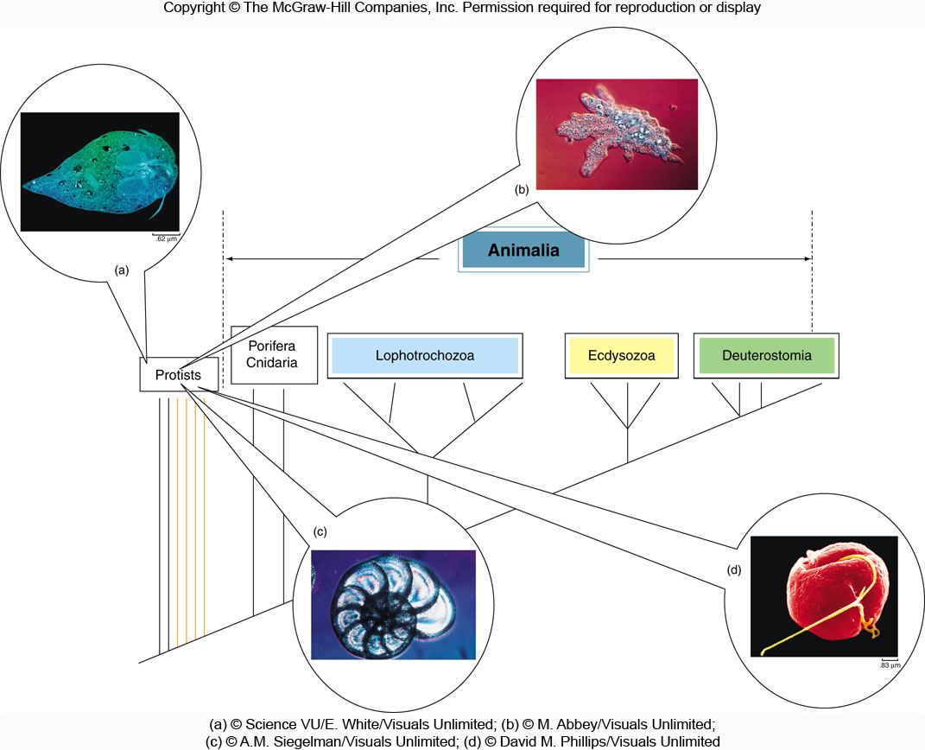
Amoebozoa变形虫类
Excavata古虫类
Rhizaria有孔虫类
Chromalveolata囊泡藻类
The challenge of protist classification

Slide 6
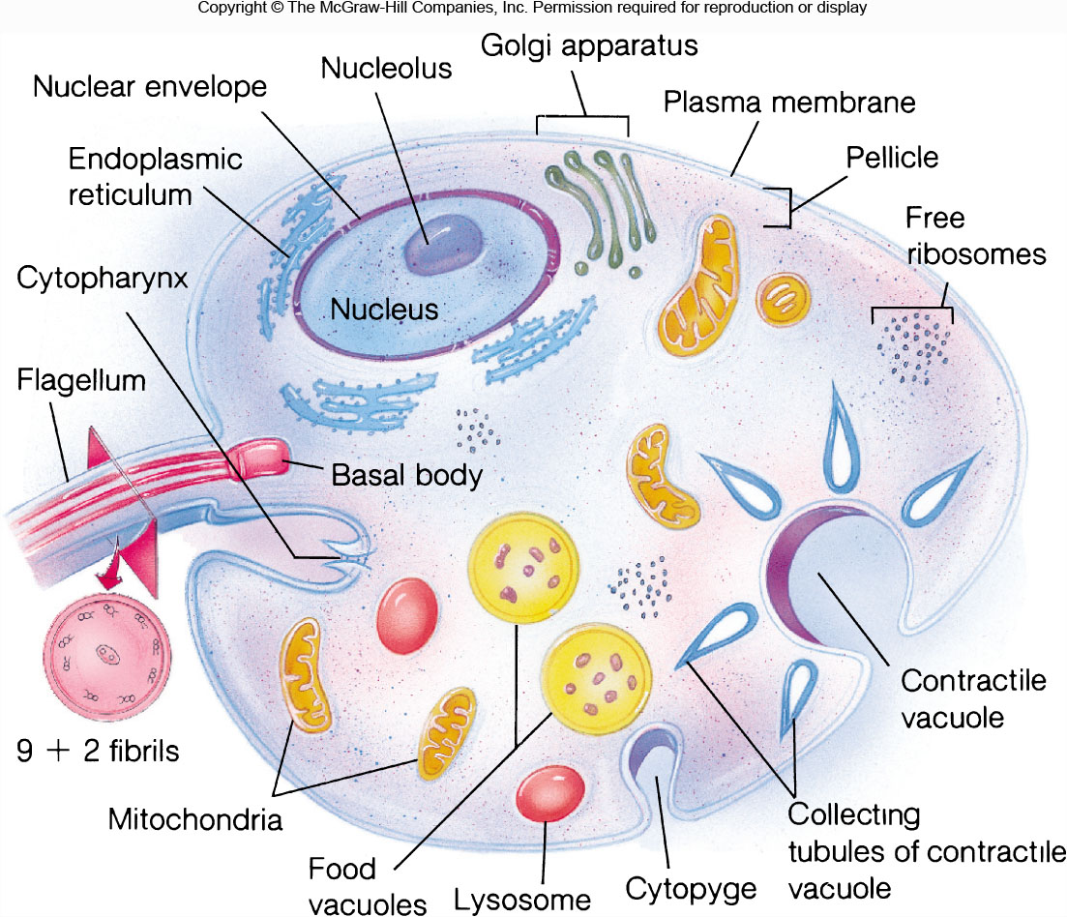
6.2 Composition of a protozoan
薄膜
吞噬泡
胞肛

Slide 7
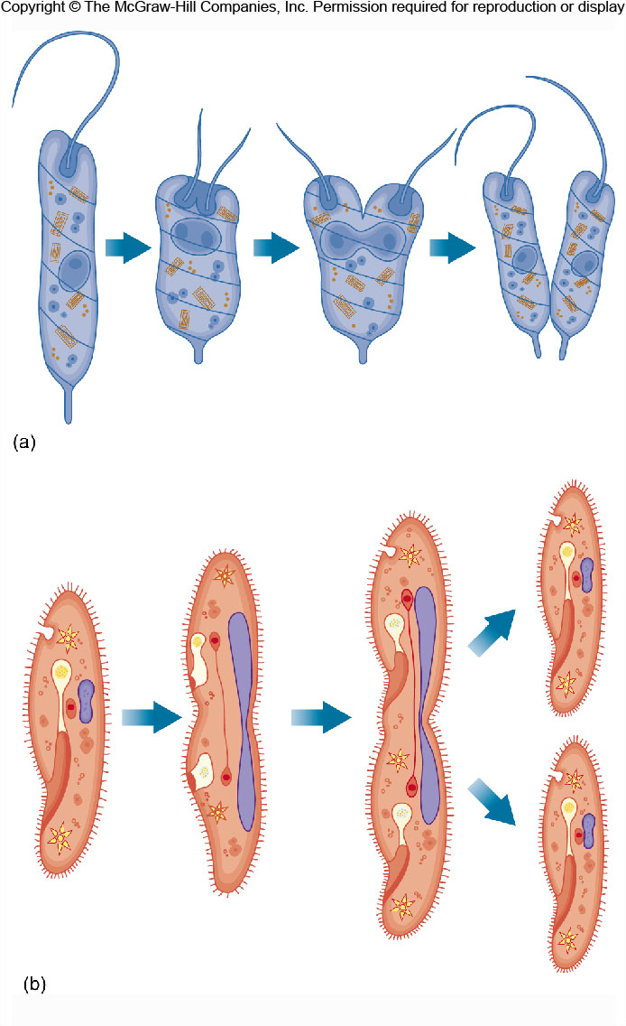
Mostly asexual reproduction in Protozoa
Longitudinal binary fission
(e.g., euglenoids)
Transverse binary fission
(e.g., ciliates)

Slide 8
6.3 Symbiotic lifestyle
Many protozoa have symbiotic lifestyles.
Concepts:
(1) Parasitism: interactions involving a form of symbiosis.
(2) Host: an organism that another organism (parasite) lives in or on.
(3) Definitive host: harbors the sexual stages of the parasite
(4) Intermediate host: additional host
(5) Commensalism共生: a symbiotic relationship in which one member benefits, and the second is neither benefited nor harmed.
(6) Mutualism互利共生：a symbiotic relationship in which both species benefit.

Slide 9
6.4 Protozoan taxonomy
SUPER GROUP | FEATURES | FIRST RANK | EXAMPLES
Excavata | Flagellum | Fonnicata | Giardia梨形鞭毛虫
古虫类 |  | Parabasalia | Trichomonas毛滴虫
 |  | Euglenozoa | Euglena
 |  | (领鞭毛虫） | Choanoflagellates
Amoebozoa | Pseudopodia | Tubulinea | Amoeba
变形虫类 |  | Acanthamoebidae
 |  | Entamoebida
Rhizaria | Pseudopodia | Foraminifera
有孔虫类 |  | Radiolaria
Chromalveolata |  | Alveolata | Ciliophora (ciliates)
囊泡藻类 |  | （鞭毛藻类） | Dinoflagellates

Slide 10
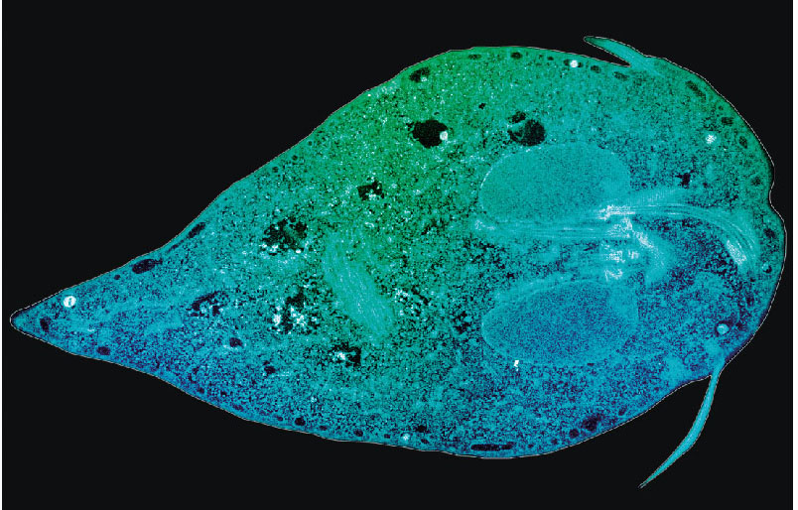
Representative protozoans
The protozoan Giardia. This parasite causes the water-borne disease
giardiasis梨形鞭毛虫病 in animals and humans.

Slide 11
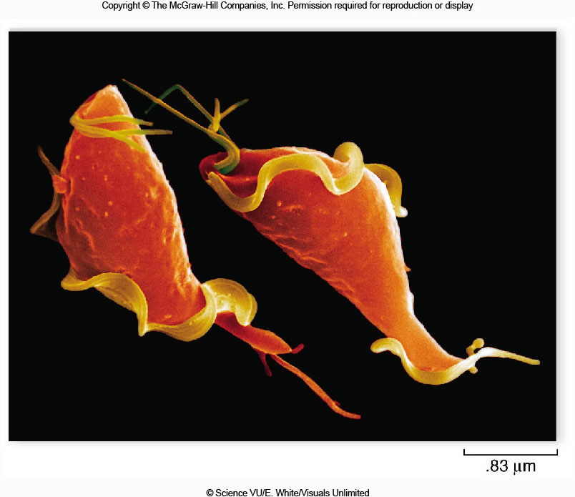
Figure 8.06
The protozoan Trichomonas vaginalis. This parasite causes the sexually transmitted disease trichomoniasis in humans.

Slide 12
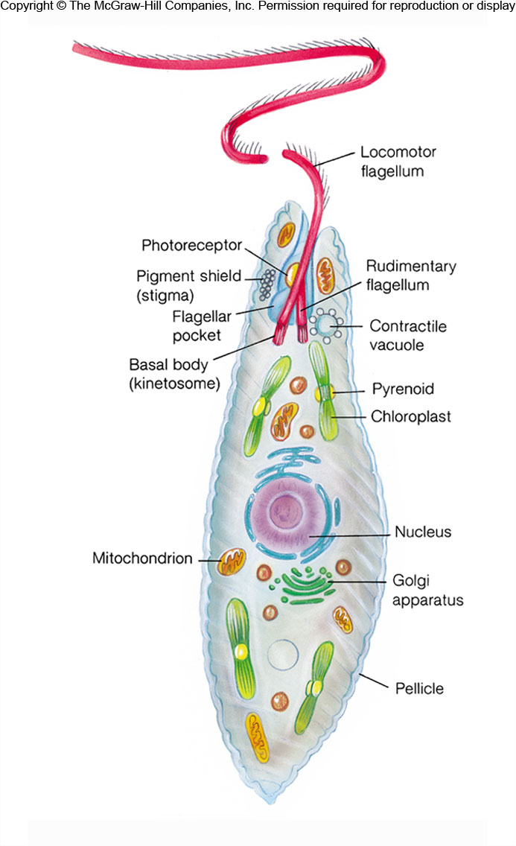
The structure of
Euglena绿眼虫
蛋白核

Slide 13
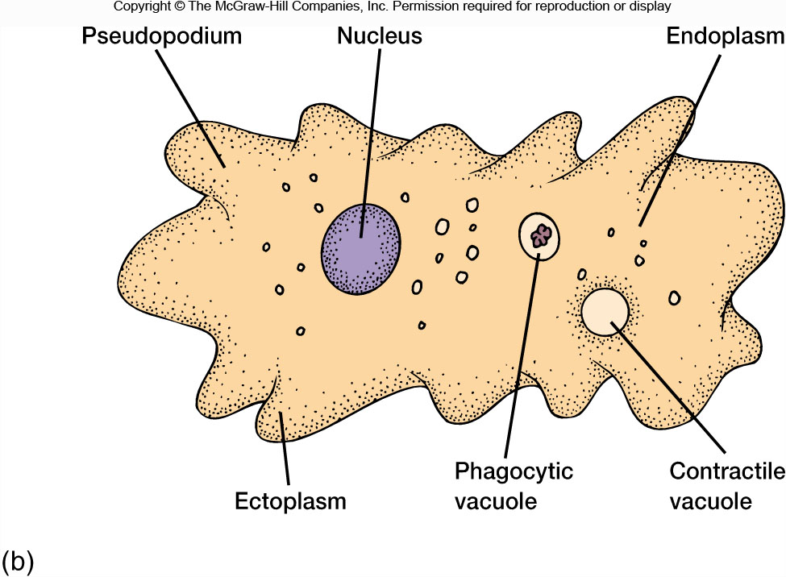
Figure 8.10b
吞噬泡
Anatomy of an amoebozoan

Slide 14
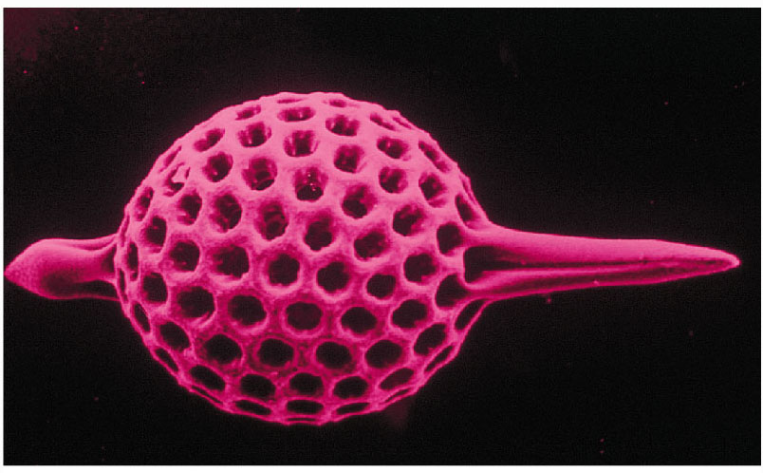
Figure 8.13b
Test of a species of Rhizaria

Slide 15
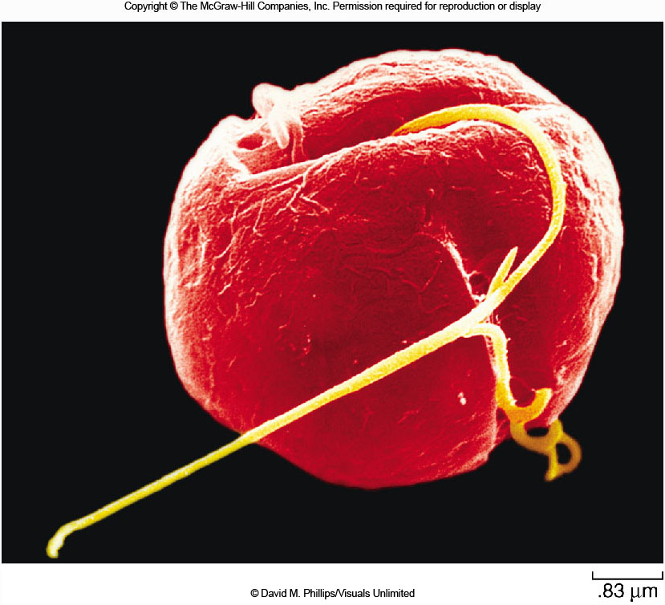
Figure 8.14
A Dinoflagellate腰鞭毛虫. Large numbers of them can color
the sea red and produce toxins that result in large fish kills.

Slide 16
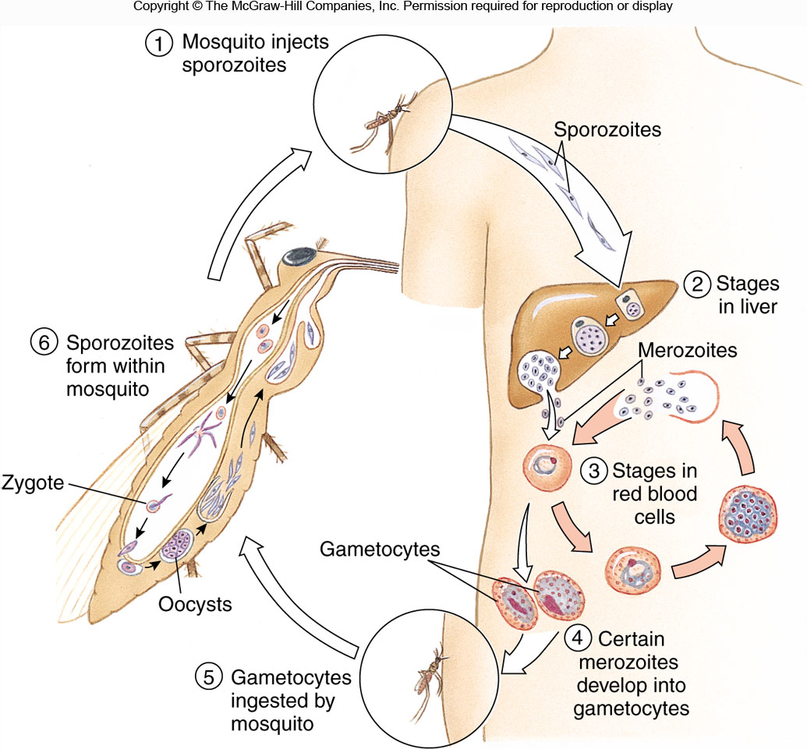
Figure 8.15
孢子体
裂殖体
配子体
The life cycle of Plasmodium疟原虫

Slide 17
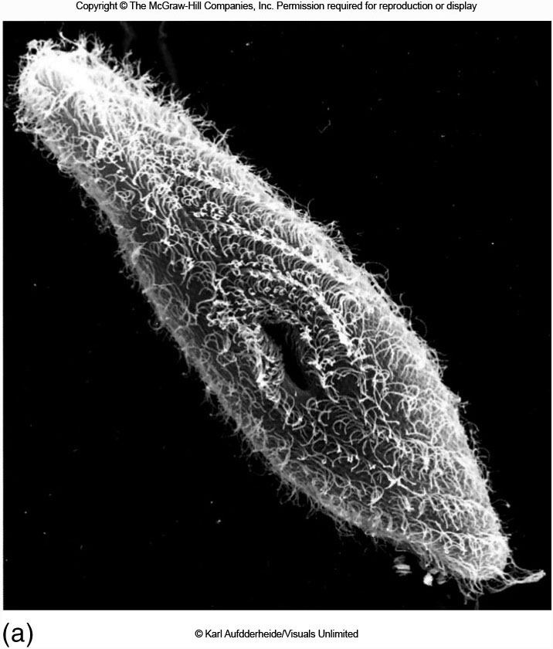
Figure 8.16a
The ciliate Paramecium sonneborn

Slide 18
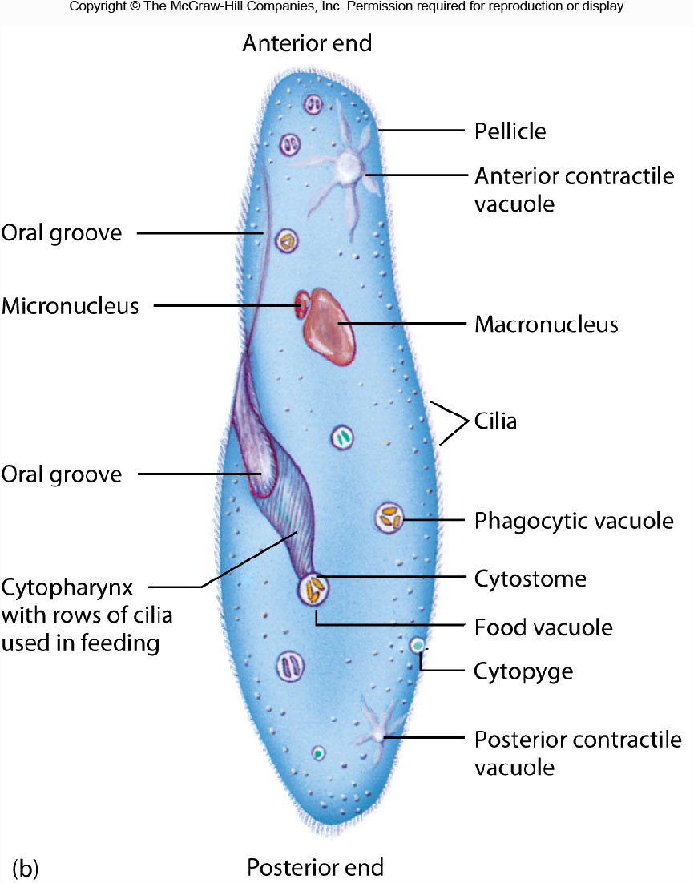
胞咽
入口孔
胞肛
The ciliate Paramecium sonneborn

Slide 19
Next Lecture
Chapter 7. Primitive multicellular animals
Chapter 8. Acoelomate triploblastic animals

